Slide 1

Strategic Threat Analysis & Cyber Resilience in National Critical Infrastructure
ACW901 - Strategic Cyber Warfare Analysis and Simulation
Student Name: RU

Slide 2
Executive Summary
Rapid summary of findings: “State-sponsored cyber operations are an integral element of Russia’s hybrid warfare, with profound impacts on CI, economy, and governance.”
Persistent, multi-vector, state–proxy operations
Evolving TTPs mapped to MITRE ATT&CK
High risk of spillover → NATO, supply chains

Slide 3







Key Objectives
Recommend resilience, deterrence, governance actions
Analyse Russian cyber campaigns against Ukraine’s CI
Assess direct & indirect impacts
Map kill chain phases and unique exploits

Slide 4

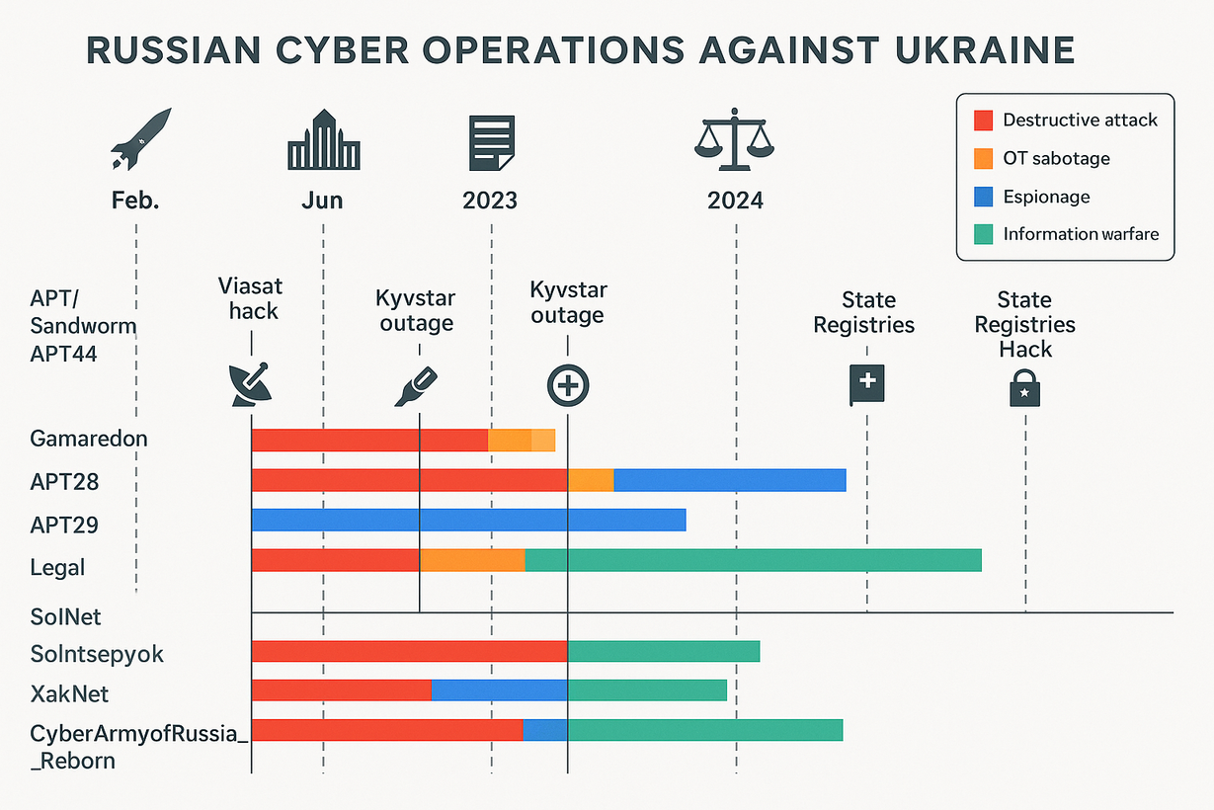
THYNK UNLIMITED
Timeline Snapshot
Timeline of Major Russian Cyber Operations Against Ukraine (2022–2024). The diagram illustrates the overlap of destructive malware campaigns, espionage operations, proxy hacktivist actions, and the integration of cyber and kinetic strikes, contextualized with major geopolitical and legal developments.

Slide 5
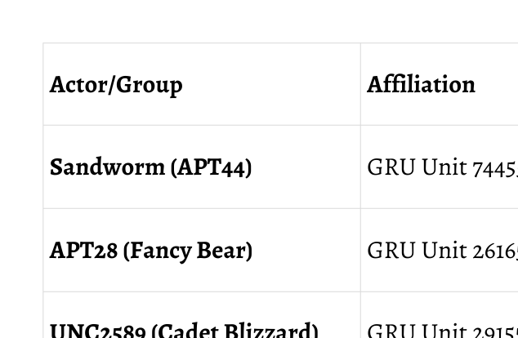
Major Threat Actors

Slide 6
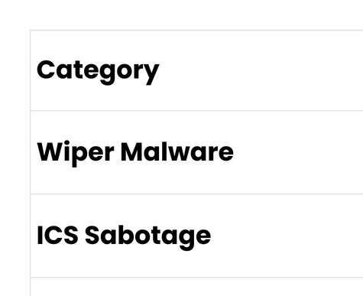
TOOLS & TACTICS

Slide 7
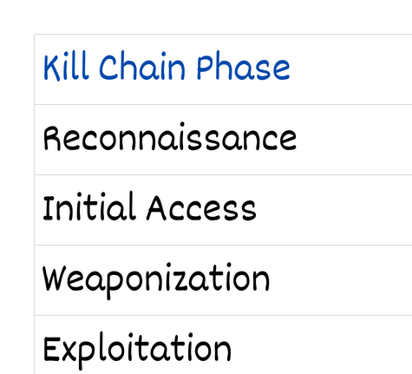
MITRE ATT&CK Kill Chain

Slide 8
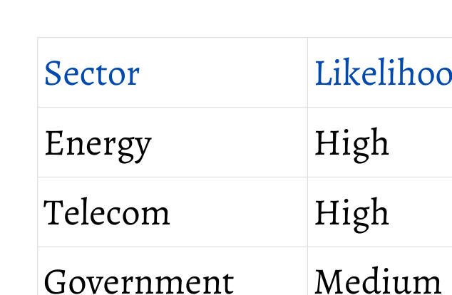
Impact & Risk Map

Slide 9
Strategic Recommendations
Defensive: Zero Trust, segmentation, proactive hunting
Legal: Preserve evidence, push IHL norms
Offensive: Calibrated deterrence, NATO posture
Capacity: CERT integration, public–private, training

Slide 10

Conclusion
"Hybrid threats are the new normal. National cyber resilience must be continuous, collective, and strategic."
Hybrid warfare = digital + physical
Early detection + int’l collaboration vital
Spillover risk → global resilience needed

